Slide 1
Operator Overloading

Slide 2
Operator Overloading
C++ has the ability to provide the operators with the special meaning for a data type.
The mechanism of giving such special meanings to an operator is known as Operator overloading.
It provides a flexible option for creation of new definitions for most of C++ operators.
Operator Overloading is a specific case of polymorphism in which some or all of operators like +, =, or == have different implementations depending on the types of their arguments.

Slide 3
Contt….
We can overload all C++ operators except the following:
Class member access operator(.,.*).
Scope resolution operators(::);
Size operator( sizeof).
Conditional operators(?:)

Slide 4
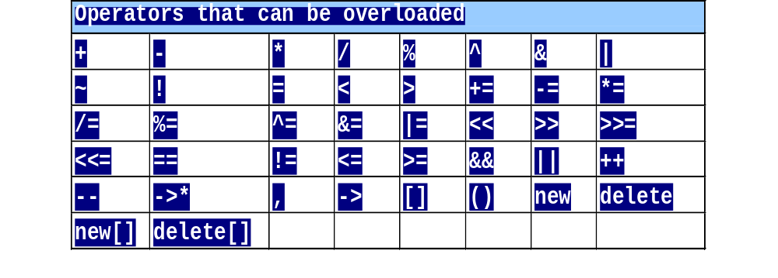
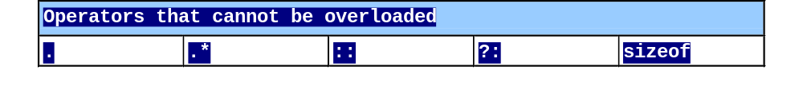
Restrictions on Operator Overloading

Slide 5
Fundamentals of Operator Overloading
Types
  Built in (int, char) or user-defined
  Can use existing operators with user-defined types
    Cannot create new operators
    Semantics of an operator can be extended but syntax cannot be changed.
Overloading operators
  Create a function for the class
  Name function operator followed by symbol
    Operator+ for the addition operator +

Slide 6
Restrictions on Operator Overloading
Cannot change
  How operators act on built-in data types
    i.e., cannot change integer addition
    When an operator is overloaded original meaning is not changed.
    For eg: + operator can be used to add two vectors but it can also used to add two integers.
  Precedence of operator (order of evaluation)
    Use parentheses to force order-of-operations
  Associativity (left-to-right or right-to-left)
  Number of operands
    & is unitary, only acts on one operand

Slide 7
Restrictions on Operator Overloading
Cannot create new operators
Operators must be overloaded explicitly
  Overloading + does not overload +=

Slide 8
Syntax
return_type operator # (argument list)
{………..}
Eg-
Complex operator +(complex);
Void operator >(distance);

Slide 9
First of all we must specify the class to which the operator is applied.
Function used for this is called operator function.
return-type classname:: operator op(arglist)
{
function body;
}

Slide 10
Steps in process of overloading
Create a class that defines data types that is to be used in the overloading operation.
Declare the operator function operator op() in public part of the class.
Define the function to implement the required operation.

Slide 11
Types of Operator
Unary operator
Binary operator
Notes:
Student Book

Slide 12
Unary Operators
Operators attached to a single operand (-a, +a, --a, a--, ++a, a++)
Notes:
Student Book
The pre and post increment and decrement operators and overloading in different ways. This is because they have a different effect on objects and their values.
e.g. a=14;
cout << a++; // will print 14 and increment a
cout << ++a; // will increment a and print 15

Slide 13
Simple Prefix Unary Operators
Are defined by either a member function that takes no parameter or a non-member function that takes one parameter
Example:
i1.operator -()
or
operator -(i1)
or
-i1

Slide 14
class space
{
private:
int x;
int y;
int z;
public:
space(int a, int b, int c)
{
x=a;
y=b;
z=c;
}

Slide 15
void display()
{
cout<<<x;
cout<<<y;
cout<<<"\n";
}
void operator-()
{
x=-x;
y=-y;
z=-z;
}
};

Slide 16
void main()
{
clrscr();
space s(10,-20,30);
cout<<"s :";
s.display();
-s;
cout<<"s :";
s.display();
getch();
}

Slide 17
Example: Unary Operators
class UnaryExample
{
private:
int m_LocalInt;
public:
UnaryExample(int j)
{
m_LocalInt = j;
}
int operator++ ()
{
return (m_LocalInt++);
}
};
Notes:
Student Book

Slide 18
Example: Unary Operators (contd.)
void main()
{
UnaryExample object1(10);
cout << object1++; // overloaded operator results in value // 11
}
Notes:
Student Book

Slide 19
Friend function
friend void operator –(space &s); //declaration
void operator –(space &s)
{
s.x=-s.x;
s.y=-s.y;
s.z=-s.z;
}

Slide 20
Binary Operators
Operators attached to two operands (a-b, a+b, a*b, a/b, a%b, a>b, a>=b, a<b, a<=b, a==b)
Notes:
Student Book

Slide 21
Example: Binary Operators
class BinaryExample
{
private:
int m_LocalInt;
public:
BinaryExample(int j)
{
m_LocalInt = j;
}
int operator+ (BinaryExample& rhsObj)
{
return (m_LocalInt + rhsObj.m_LocalInt);
}
};
Notes:
Student Book

Slide 22
Example: Binary Operators (contd.)
void main()
{
BinaryExample object1(10), object2(20);
cout << object1 + object2; // overloaded operator called
}
ob1 = ob1 + ob2;
equivalent to
ob1 = ob1.operator+(ob2);
Notes:
Student Book

Slide 23
Eg:- class complex
{ float x;
float y;
public:
complex(){ x=10;y=20;}
complex operator -(complex c)
{
complex temp;
temp.x= x- c.x;
temp.y=y-c.y;
return(temp);
}
Void show()
{
Cout<<x<<y;
}};

Slide 24
void main()
{ complex C1,C2,C3;
C3=C1-C2;
C3.show();
}

Slide 25
#include <iostream.h>
class Exforsys
{
private:
int x;
int y;
public:
Exforsys() //Constructor
{ x=0; y=0; }
void getvalue( ) //Member Function for Inputting Values
{
cout << “\n Enter value for x: “;
cin >> x;
cout << “\n Enter value for y: “;
cin>> y;
}
void displayvalue( ) //Member Function for Outputting Values
{
cout <<”value of x is: “ << x <<”; value of y is: “<<y
}
Exforsys operator +(Exforsys);
};

Slide 26
Exforsys Exforsys :: operator + (Exforsys e2)
//Binary operator overloading for + operator defined
{
Exforsys temp;
temp.x = x+ e2.x;
temp.y = y+e2.y;
return temp;
}
void main( )
{
Exforsys e1,e2,e3; //Objects e1, e2, e3 created
cout<<\n”Enter value for Object e1:”;
e1.getvalue( );
cout<<\n”Enter value for Object e2:”;
e2.getvalue( );
e3= e1+ e2; //Binary Overloaded operator used
cout<< “\nValue of e1 is:”<<e1.displayvalue();
cout<< “\nValue of e2 is:”<<e2.displayvalue();
cout<< “\nValue of e3 is:”<<e3.displayvalue();
}

Slide 27
The output of the program is:
Enter value for Object e1:
Enter value for x: 10
Enter value for y: 20
Enter value for Object e2:
Enter value for x: 30
Enter value for y: 40
Value of e1 is: value of x is: 10; value of y is: 20
Value of e2 is: value of x is: 30; value of y is: 40
Value of e3 is: value of x is: 40; value of y is: 60

Slide 28
Rules for overloading operators.
Only existing operators can be overloaded. New operators cannot be created.
The overloaded operator must have at least one operand that is of user defined type.
We cannot change the basic meaning of the operator.
Overloaded operators follow the syntax rules of the original operators. They cannot be overridden.

Slide 29
Rules for overloading operators.
There are some operators that cannot be overloaded.
We cannot use friend functions to overload certain operators. Member functions can be used to overload them.
Unary operators overloaded by means of member function, take no explicit arguments and return no explicit values.

Slide 30
Rules for overloading operators.
Binary operators overloaded through a member function take two explicit arguments.
When using binary operators overloaded through a member function, the left hand operand must be an object of the relevant class.

